Slide 1
Welcome to
IBDP History

Slide 2
It is easiest to think of SL and HL as two separate courses in one.
In both you will…
Form an argument
Write discussions
Read LOTS
Write LOTS
Know LOTS
Use evidence

Slide 3
Assessment Objective
AO1 | Knowledge and understanding | Demonstrate detailed, relevant and accurate historical knowledge. Demonstrate understanding of historical concepts and context. Demonstrate understanding of historical sources. (Internal assessment and paper 1)
AO2 | Application and analysis | Formulate clear and coherent arguments. Use relevant historical knowledge to effectively support analysis. Analyse and interpret a variety of sources. (Internal assessment and paper 1)
AO3 | Synthesis and evaluation | Integrate evidence and analysis to produce a coherent response. Evaluate different perspectives on historical issues and events, and integrate this evaluation effectively into a response. Evaluate sources as historical evidence, recognizing their value and limitations. (Internal assessment and paper 1) Synthesize information from a selection of relevant sources. (Internal assessment and paper 1)
AO4 | Use and application of appropriate skills | Structure and develop focused essays that respond effectively to the demands of a question. Reflect on the methods used by, and challenges facing, the historian. (Internal assessment) Formulate an appropriate, focused question to guide a historical inquiry. (Internal assessment) Demonstrate evidence of research skills, organization, referencing and selection of appropriate sources. (Internal assessment)

Slide 4
Command term | AO | Definition
Analyse | AO2 | Break down in order to bring out the essential elements or structure.
Compare | AO3 | Give an account of the similarities between two (or more) items or situations, referring to both (all) of them throughout.
Compare and contrast | AO3 | Give an account of similarities and differences between two (or more) items or situations, referring to both (all) of them throughout.
Contrast | AO3 | Give an account of the differences between two (or more) items or situations, referring to both (all) of them throughout.
Discuss | AO3 | Offer a considered and balanced review that includes a range of arguments, factors or hypotheses. Opinions or conclusions should be presented clearly and supported by appropriate evidence.
Evaluate | AO3 | Make an appraisal by weighing up the strengths and limitations.
Examine | AO3 | Consider an argument or concept in a way that uncovers the assumptions and interrelationships of the issue.
To what extent | AO3 | Consider the merits or otherwise of an argument or concept. Opinions and conclusions should be presented clearly and supported with appropriate evidence and sound argument.

Slide 5
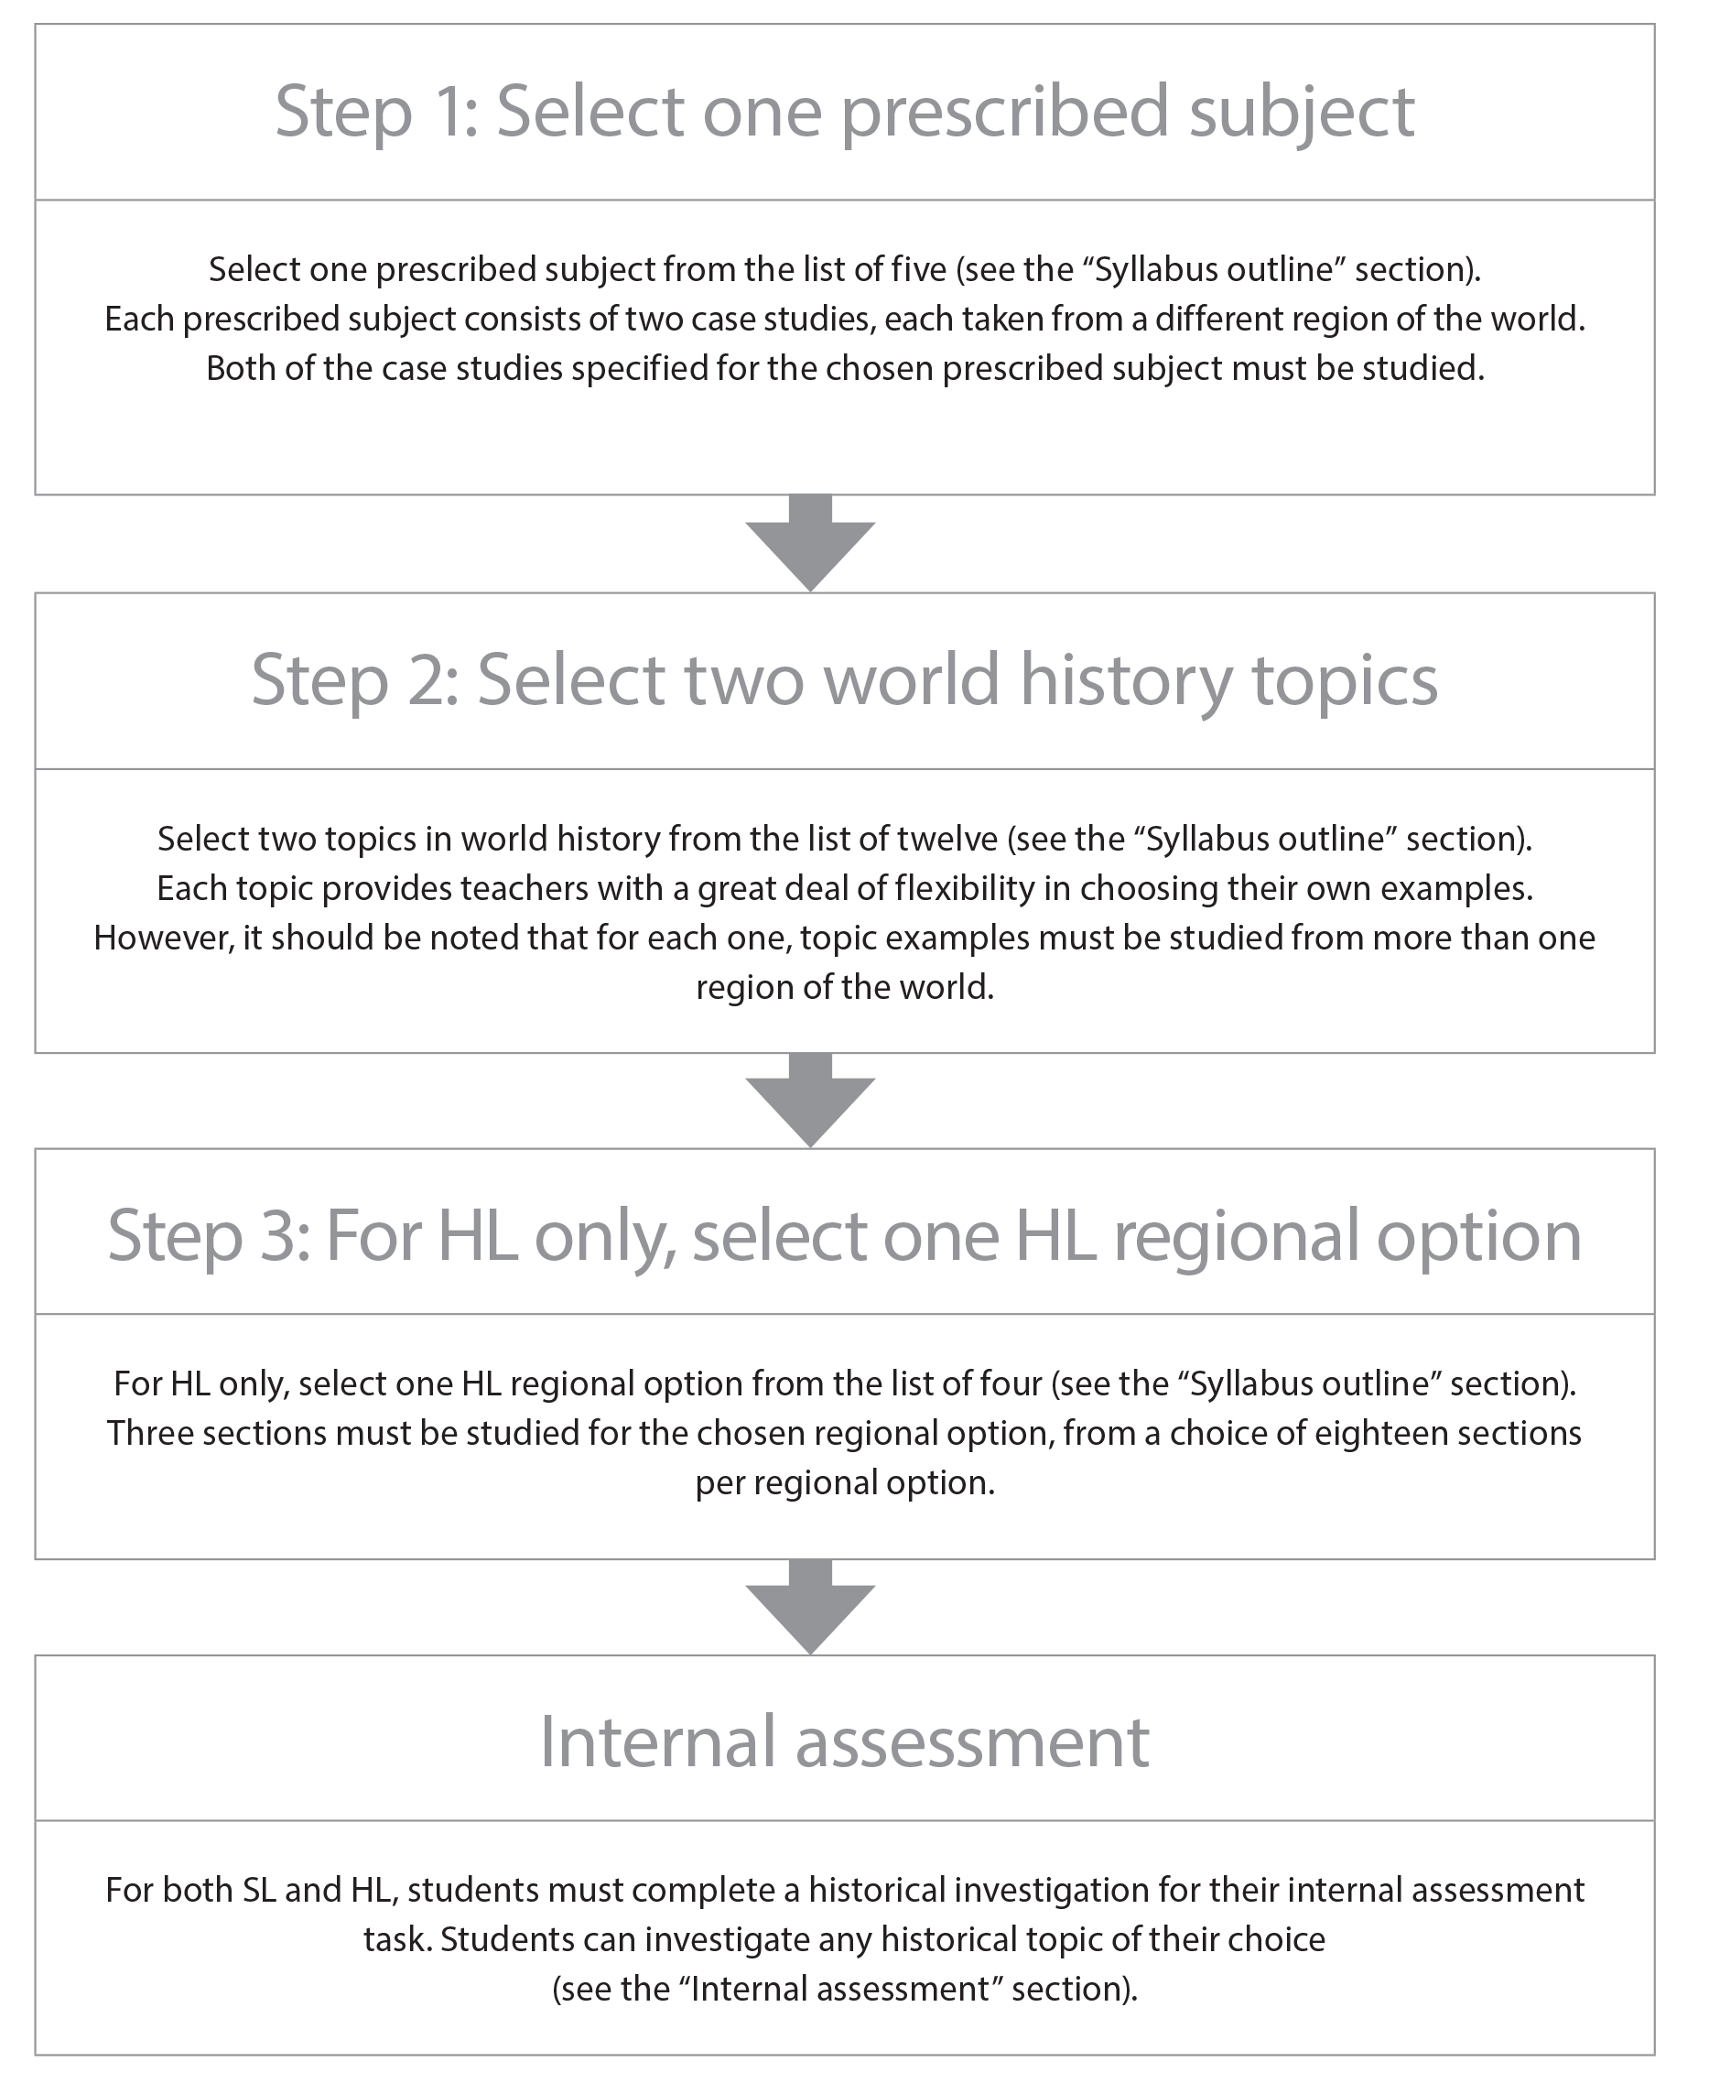
Rights and Protest
Societies in transition (1400–1700)
Origins, development and impact
of industrialization (1750–2005)
History of the Americas
Own choice

Slide 6
Paper 1 (SL)
Source-based paper based on the five prescribed subjects. Choose one prescribed subject from a choice of five. Answer four structured questions. (24 marks)
1 hour
The paper will contain four sources for each prescribed subject. Sources will be primary or a mixture of primary and secondary, and may be written, pictorial or diagrammatic. The paper will consist of four questions for each prescribed subject, and students must answer all four questions from their chosen prescribed subject. Some questions will be answered using only evidence from one or more of the sources, as indicated. In other questions students will be asked to use their own knowledge of the prescribed subject as well as evidence contained in the sources.

Slide 7
Paper 2 (SL)
Essay paper based on the 12 world history topics. Answer two essay questions on two different topics. (30 marks)
1 hour 30 mins
The paper consists of two questions for each of the 12 topics. Students must answer two questions, each selected from a different topic. Some comparative questions on this paper require that examples be drawn from more than one region. When the word “region” is used in a paper 2 question, it refers to one of the four regional options defined by the world map in the introduction to the world history topics in the “World history topics” section.

Slide 8
Paper 3 (HL Only)
2 hr 30 m
History of the Americas paper
Answer 3 questions
One question per topic
15 marks per question
Total 45 marks
Worth 35% of the course

Slide 9
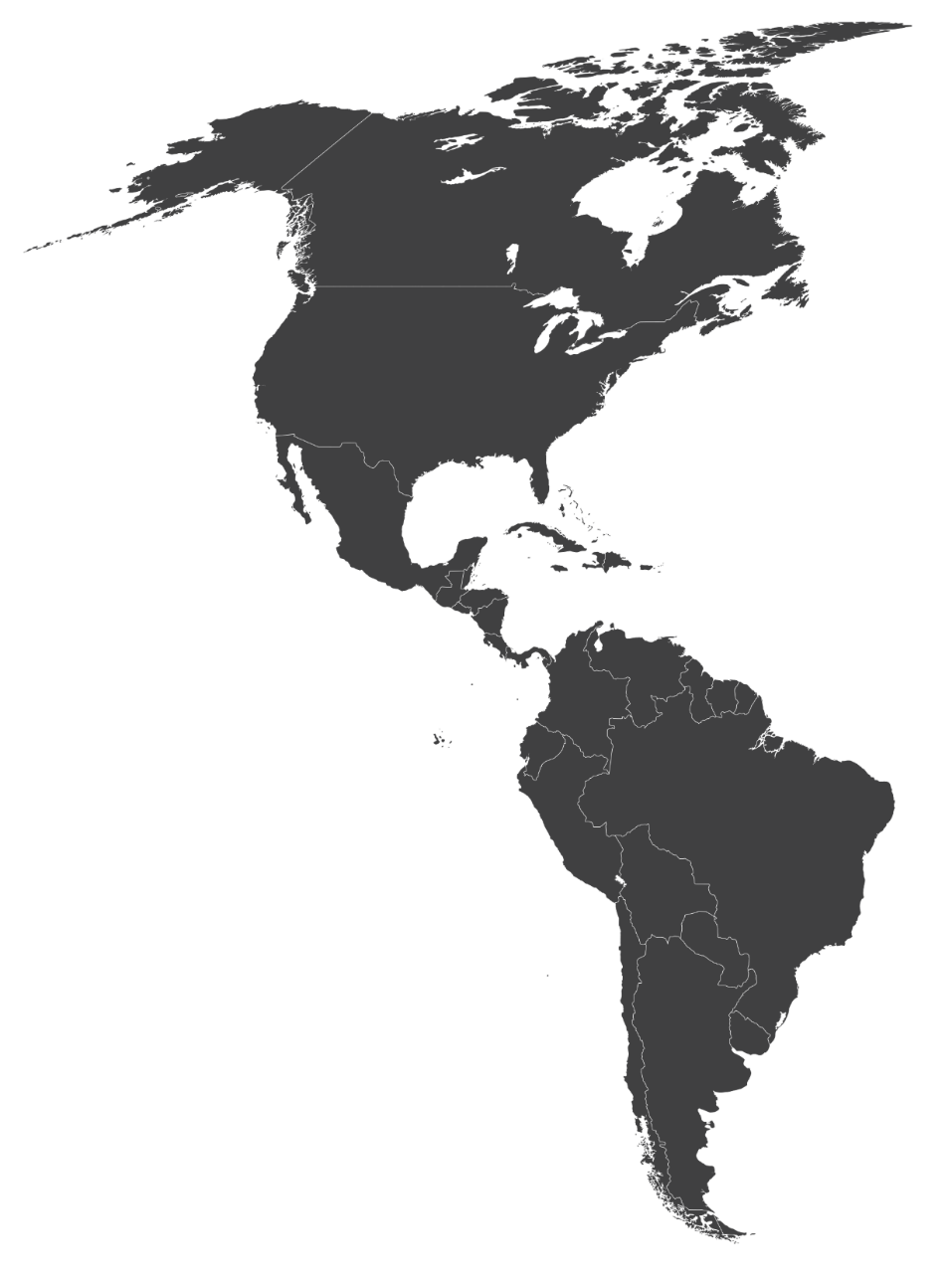
History of the Americas
Slavery and the New World (1500–1800)
United States’ Civil War: Causes, course and effects (1840–1877)
Civil rights and social movements in the Americas post-1945

Slide 10
Internal Assessment
20 hours
This component is internally assessed by the teacher and externally moderated by the IB at the end of the course.
Historical investigation
Students are required to complete a historical investigation into a topic of their choice. (25 marks)

Slide 11
Suggested Word Counts
Section | Word Count | Marks
Identification and evaluation of sources | 500 | 6
Investigation | 1300 | 15
Reflection | 400 | 4
Bibliography | N/A
Total | 2200 | 25

Slide 12
TASK
Discuss areas of interest in history
Narrow your focus to three areas
You don’t all have to have the same three

