Slide 1
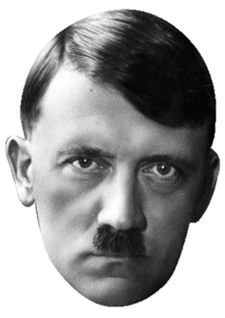
Paper 3 – Section A
What is evidence?
Statistics, people, events, laws, dates
Weimar and Nazi Germany 1918 - 1939
4 Marks
12 Marks
Give two things that you can infer from Source __ about…
Explain why…
Say one thing you work out from the source, thinking of the bigger picture, don’t just paraphrase
Quote or describe part of the source
PEEL paragraph
PEEL paragraph
Say one thing you work out from the source, thinking of the bigger picture, don’t just paraphrase
Quote or describe part of the source
PEEL paragraph

Slide 2
Paper 3 – Section B
What is evidence?
Statistics, people, events, laws, dates
Weimar and Nazi Germany 1918 - 1939
8 Marks
4 Marks
4 Marks
16 Marks (+4 SPAG)
How useful are __ and __ for an enquiry into…?
What is the main difference between…?
Suggest one reason why _ and _ give different views on…
‘…’ How far do you agree?
Source A – OPCVL
Origin, purpose, content, value, limitation
Source A is useful because…
However, its usefulness is limited by…
Come to an overall judgement about the source. How useful?
PEEL paragraph
The main difference between the two interpretations is…
Evidence from interpretation __ to support this is… [x2]
This highlights the main difference because…
PEEL paragraph
One reason why the interpretations give different views is…
Evidence from interpretation __ to support this is…
This shows that…
2-3 line intro
PEEL paragraph agree
PEEL paragraph a/d
PEEL paragraph disagree
Repeat for source B
Concl - Overall judgement
Conclusion – In my opinion…

